Slide 1
EMTH1019 W4 Estimation & hypothesis testing

Slide 2
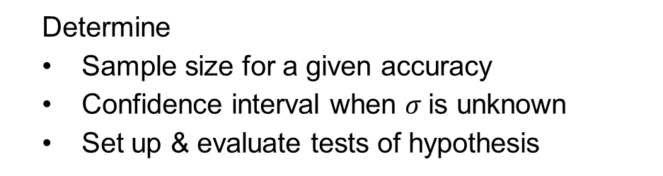
Estimation & hypothesis testing
Determine
Sample size for a given accuracy
Confidence interval when $σ$is unknown
Set up & evaluate tests of hypothesis

Slide 3
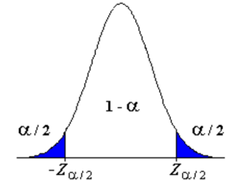
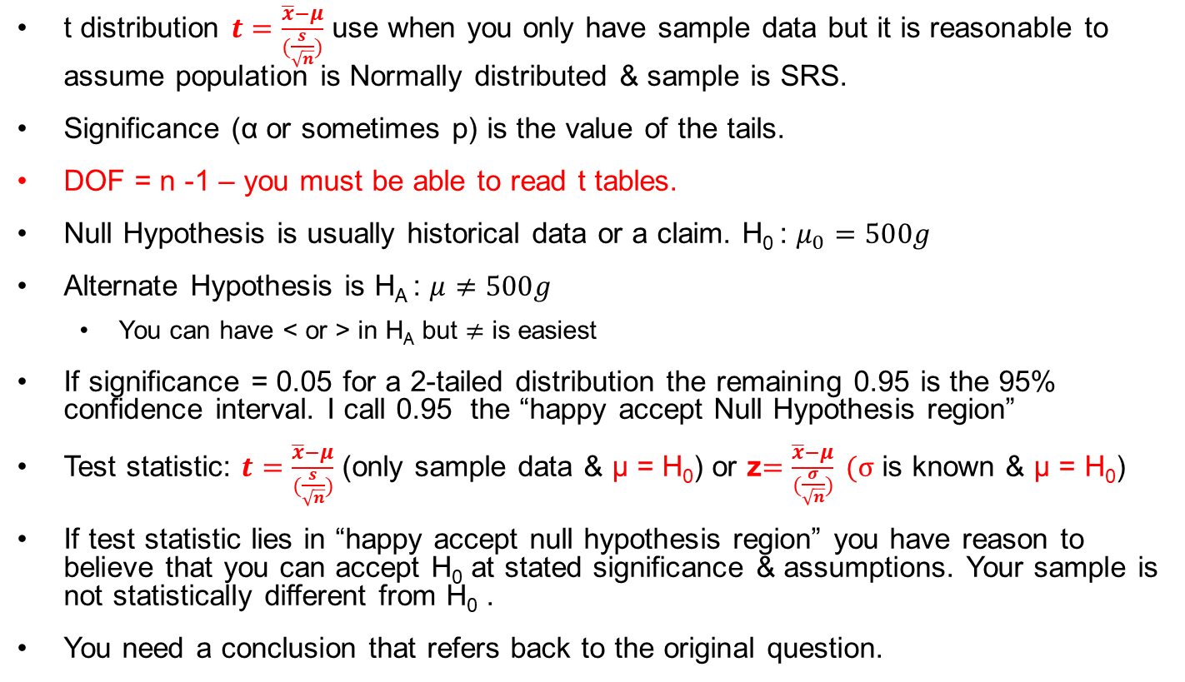
Hypothesis & t – summary sheet
t distribution $t=\frac{\overline{x}−μ}{(\frac{s}{\sqrt{n}})}$ use when you only have sample data but it is reasonable to assume population is Normally distributed & sample is SRS.
Significance (α or sometimes p) is the value of the tails.
DOF = n -1 – you must be able to read t tables.
Null Hypothesis is usually historical data or a claim. H₀ : $μ_{0}=500g$
Alternate Hypothesis is H_{A} : $μ≠500g$
You can have < or > in H_{A} but $≠$ is easiest
If significance = 0.05 for a 2-tailed distribution the remaining 0.95 is the 95% confidence interval. I call 0.95 the “happy accept Null Hypothesis region”
Test statistic: $t=\frac{\overline{x}−μ}{(\frac{s}{\sqrt{n}})}$ (only sample data & µ = H₀) or z$=\frac{\overline{x}−μ}{(\frac{σ}{\sqrt{n}})} (σ$ is known & µ = H₀)
If test statistic lies in “happy accept null hypothesis region” you have reason to believe that you can accept H₀ at stated significance & assumptions. Your sample is not statistically different from H₀ .
You need a conclusion that refers back to the original question.

Slide 4
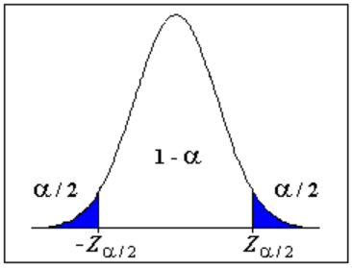

Margin of error
When we looked at confidence intervals last week…
$$−z_{α/2}<\frac{\overline{x}−μ}{\frac{σ}{\sqrt{n}}}<z_{α/2}$$
If we rearrange the equation by * $\frac{σ}{\sqrt{n}}$
$$\left(−z_{α/2}\right)∗\frac{σ}{\sqrt{n}}<\overline{x}−μ<{(z}_{α/2})∗\frac{σ}{\sqrt{n}}$$
The margin of error is $\left|\overline{x}−μ\right|$

Slide 5

using margin of error to calculate sample size
If I let the margin of error $\left|\overline{x}−μ\right|=E$
Then
$$E={(z}_{α/2})∗\frac{σ}{\sqrt{n}}$$
Re-arrange
$$\sqrt{n}={(z}_{α/2})∗\frac{σ}{E}$$
Square both sides
$$n={{((z}_{α/2})∗\frac{σ}{E})}^{2}$$
Whatever $n$ you calculate, always round up

Slide 6
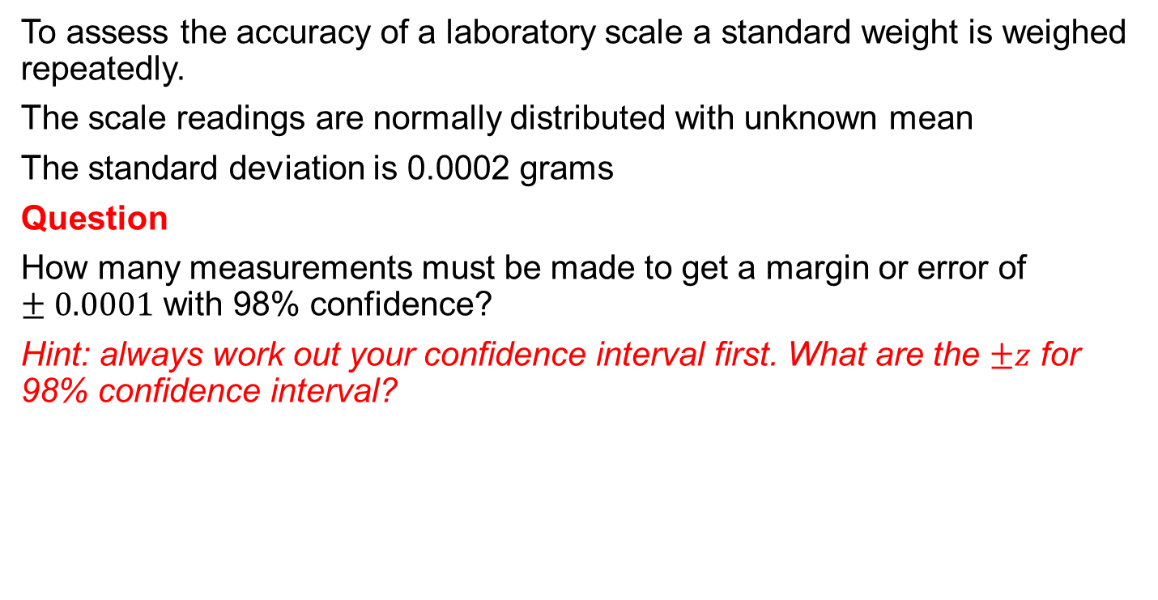
Example: How many measurements?
To assess the accuracy of a laboratory scale a standard weight is weighed repeatedly.
The scale readings are normally distributed with unknown mean
The standard deviation is 0.0002 grams
Question
How many measurements must be made to get a margin or error of $±0.0001$ with 98% confidence?
Hint: always work out your confidence interval first. What are the $±z$ for 98% confidence interval?

Slide 7
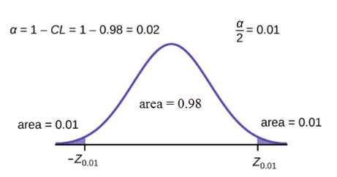
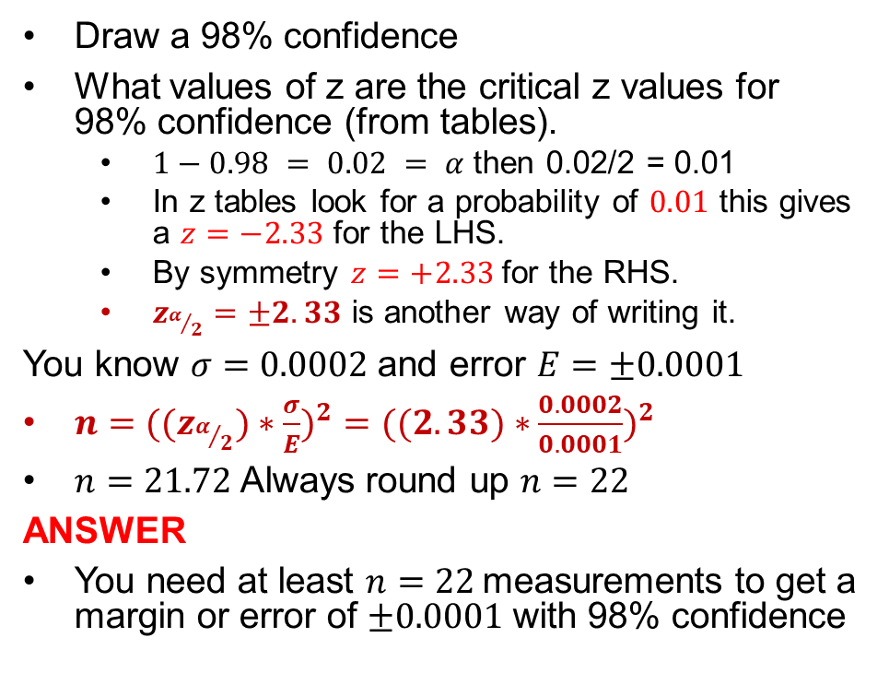
Solution: how many measurements?
Draw a 98% confidence
What values of z are the critical z values for 98% confidence (from tables).
$1−0.98 = 0.02 = α$then 0.02/2 = 0.01
In z tables look for a probability of $0.01$ this gives a $z=−2.33$ for the LHS.
By symmetry $z=+2.33$for the RHS.
$z_{α/2}=±2.33$ is another way of writing it.
You know $σ=0.0002$ and error $E=±0.0001$
$n={{((z}_{α/2})∗\frac{σ}{E})}^{2}={((2.33)∗\frac{0.0002}{0.0001})}^{2}$
$n=21.72$ Always round up $n=22$
ANSWER
You need at least $n=22$measurements to get a margin or error of $±0.0001$ with 98% confidence

Slide 8
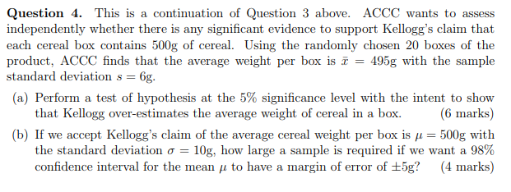
CU Past exam question
Part (b) is a margin of error question

Slide 9
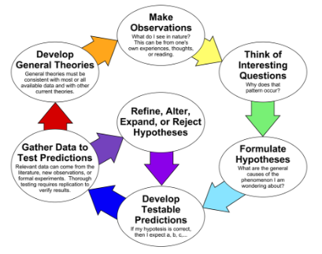
Scientific method
https://raeonscience.weebly.com/the-scientific-method.html

Slide 10
hypothesis
Is a proposed explanation for a phenomenon
Hypothesis testing is at the heart of the scientific method.
This week we will be dealing with:
Null Hypothesis H₀
Is the commonly accepted fact
States a claim that we assume to be true unless we can find sufficient evidence to indicate it is not true.
Alternate Hypothesis H_{A}
Opposite of the Null Hypothesis.
Is a statement that we hope or suspect is true but we need sufficient evidence to support it before we are willing to accept it.

Slide 11
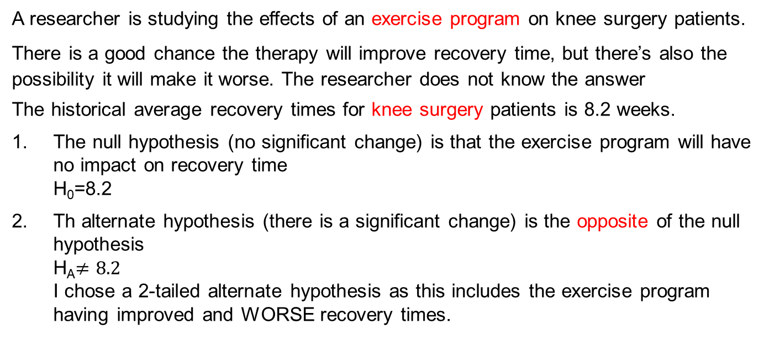
Example of null & alternate hypotheses
A researcher is studying the effects of an exercise program on knee surgery patients.
There is a good chance the therapy will improve recovery time, but there’s also the possibility it will make it worse. The researcher does not know the answer
The historical average recovery times for knee surgery patients is 8.2 weeks.
The null hypothesis (no significant change) is that the exercise program will have no impact on recovery time H₀=8.2
Th alternate hypothesis (there is a significant change) is the opposite of the null hypothesis H_{A}$≠8.2$ I chose a 2-tailed alternate hypothesis as this includes the exercise program having improved and WORSE recovery times.

Slide 12
Problems with hypothesis tests
The out come of a statistical test is to either accept or not accept the Null Hypothesis.
If you cannot accept H₀ then you are inclined to accept hypothesis H_{A}
Your data sample may provide a good representation of the population then your conclusion might be true
Or
Your sample data leads you to not accept H_{O} even though it is actually true for the population.
Or
You accept the H_{O} as your sample indicates there is no significant change, but your sample is not representative of the population

Slide 13

The boy who cried wolf
This story is attributed to Aesop (620 – 564 BCE)
A naughty shepherd boy repeatedly fools villagers into believing a wolf is attacking his flock of sheep calling out “ wolf, wolf “ when there is no wolf.
A real wolf appears and the boy calls for help “ wolf, wolf ”. The villagers hear the cry but believe it is another false alarm and do not help.
The sheep are eaten by the wolf and in some versions of the fable so is the boy!
Moral of the story
Liars are not believed – even when they speak the truth.
https://www.pinterest.com.au/pin/507288345498566353/

Slide 14
You are guarding your sheep
The null hypothesis is H_{O} = no wolf is present
The alternate hypothesis H_{A}= there is a wolf present
Type 1 error or False Positive or False Alarm
Assert something is true when it is not true
A false positive is crying “wolf, wolf!!” when there is no wolf present
You have rejected H_{O}, and accepted H_{A} , but it is H_{O} that is true
Type 2 error or False Negative
Assert something is false when it is true.
There is a dangerous wolf present, but you think there is no wolf.
You have accepted H_{O}, when it is H_{A} that is true
https://infocus.dellemc.com/william_schmarzo/understanding-type-i-and-type-ii-errors/

Slide 15
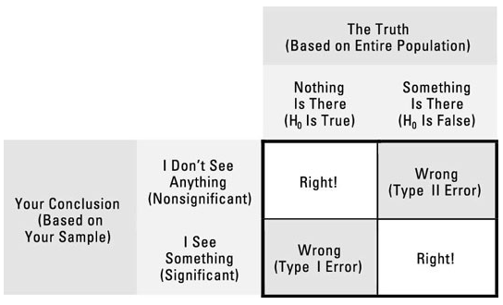
Type 1 and 2 errors continued
https://www.dummies.com/education/science/biology/type-i-and-type-ii-errors-in-hypothesis-testing/

Slide 16
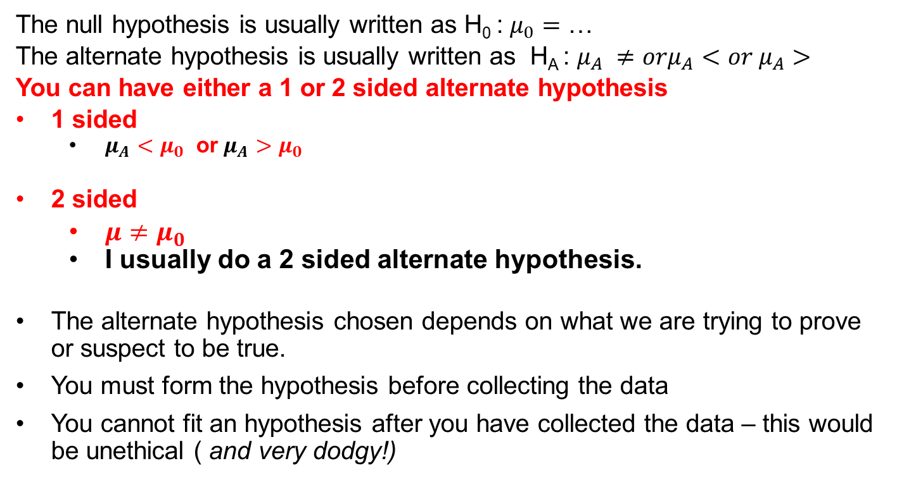
1 & 2 sided Alternate Hypotheses
The null hypothesis is usually written as H₀ : $μ_{0}=$ …
The alternate hypothesis is usually written as H_{A} : $μ_{A} ≠orμ_{A}<or{ μ}_{A}>$
You can have either a 1 or 2 sided alternate hypothesis
1 sided
$μ_{A}<μ_{0}$ or$μ_{A}>μ_{0}$
2 sided
$μ≠μ_{0}$
I usually do a 2 sided alternate hypothesis.
The alternate hypothesis chosen depends on what we are trying to prove or suspect to be true.
You must form the hypothesis before collecting the data
You cannot fit an hypothesis after you have collected the data – this would be unethical ( and very dodgy!)

Slide 17
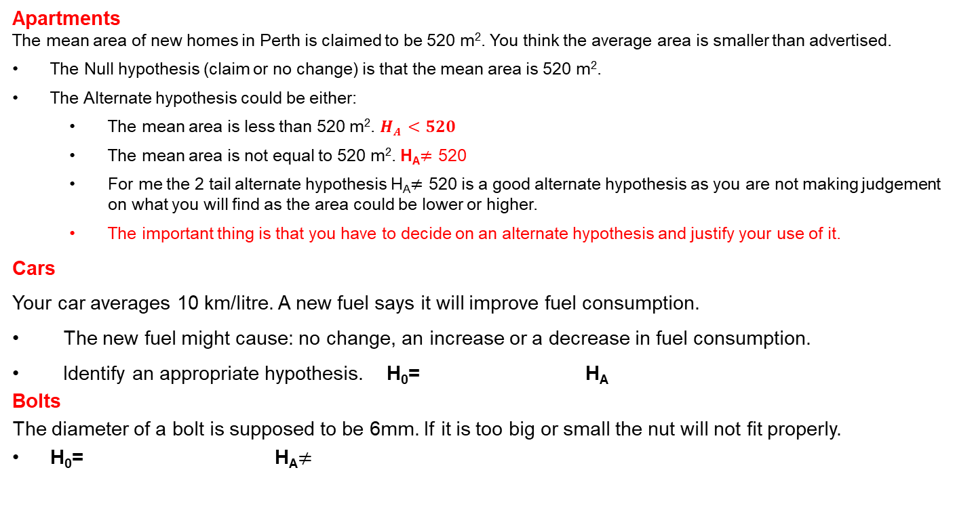
Setting up hypotheses
Apartments
The mean area of new homes in Perth is claimed to be 520 m². You think the average area is smaller than advertised.
The Null hypothesis (claim or no change) is that the mean area is 520 m².
The Alternate hypothesis could be either:
The mean area is less than 520 m². $HA <520$
The mean area is not equal to 520 m². H_{A}$≠$ 520
For me the 2 tail alternate hypothesis H_{A}$≠$ 520 is a good alternate hypothesis as you are not making judgement on what you will find as the area could be lower or higher.
The important thing is that you have to decide on an alternate hypothesis and justify your use of it.
Cars
Your car averages 10 km/litre. A new fuel says it will improve fuel consumption.
The new fuel might cause: no change, an increase or a decrease in fuel consumption.
Identify an appropriate hypothesis. H₀= H_{A}
Bolts
The diameter of a bolt is supposed to be 6mm. If it is too big or small the nut will not fit properly.
H₀= H_{A}$≠$

Slide 18
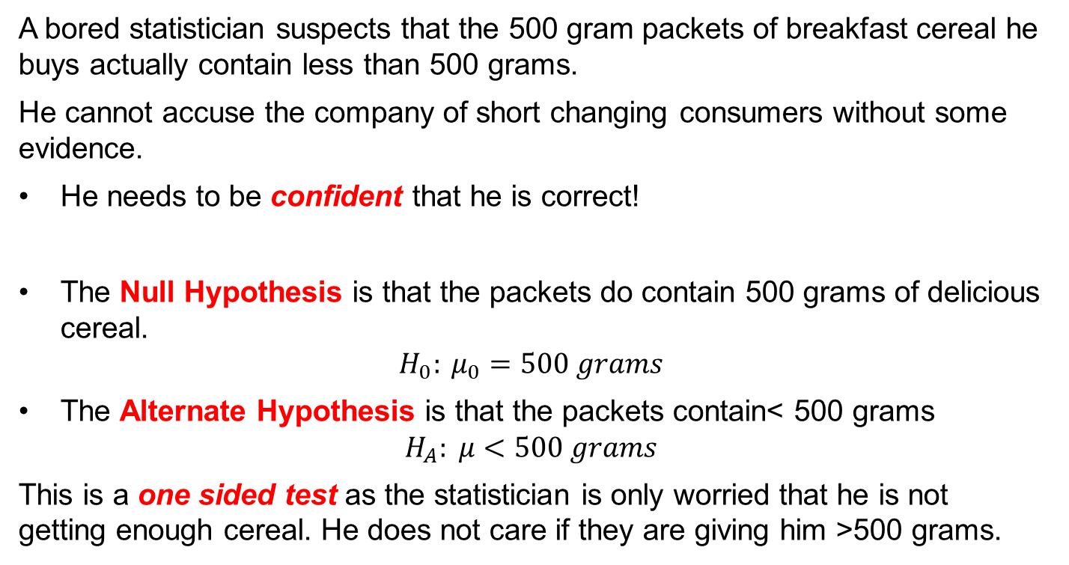
Hypotheses for Breakfast
A bored statistician suspects that the 500 gram packets of breakfast cereal he buys actually contain less than 500 grams.
He cannot accuse the company of short changing consumers without some evidence.
He needs to be confident that he is correct!
The Null Hypothesis is that the packets do contain 500 grams of delicious cereal.
$$H_{0}: μ_{0}=500 grams$$
The Alternate Hypothesis is that the packets contain< 500 grams
$$H_{A}: μ<500 grams$$
This is a one sided test as the statistician is only worried that he is not getting enough cereal. He does not care if they are giving him >500 grams.

Slide 19
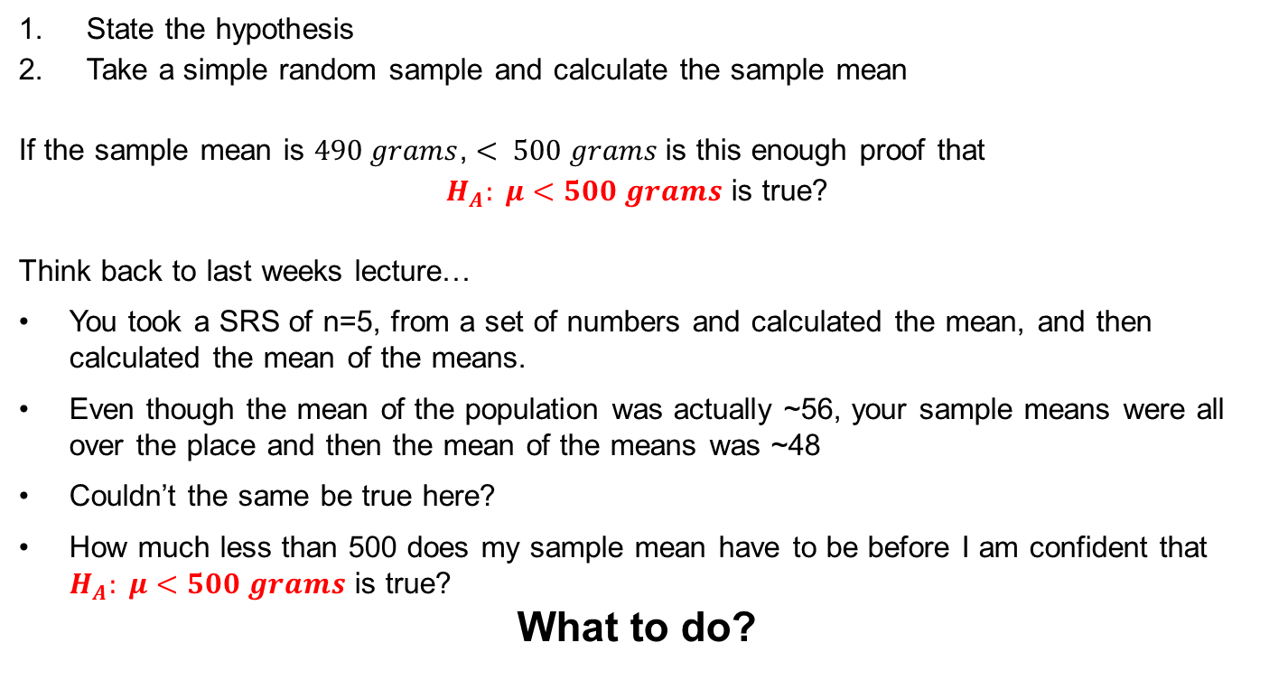
To test the cereal hypothesis…
State the hypothesis
Take a simple random sample and calculate the sample mean
If the sample mean is $490 grams$, $< 500 grams$is this enough proof that
$H_{A}: μ<500 grams$ is true?
Think back to last weeks lecture…
You took a SRS of n=5, from a set of numbers and calculated the mean, and then calculated the mean of the means.
Even though the mean of the population was actually ~56, your sample means were all over the place and then the mean of the means was ~48
Couldn’t the same be true here?
How much less than 500 does my sample mean have to be before I am confident that $H_{A}: μ<500 grams$ is true?
What to do?

Slide 20
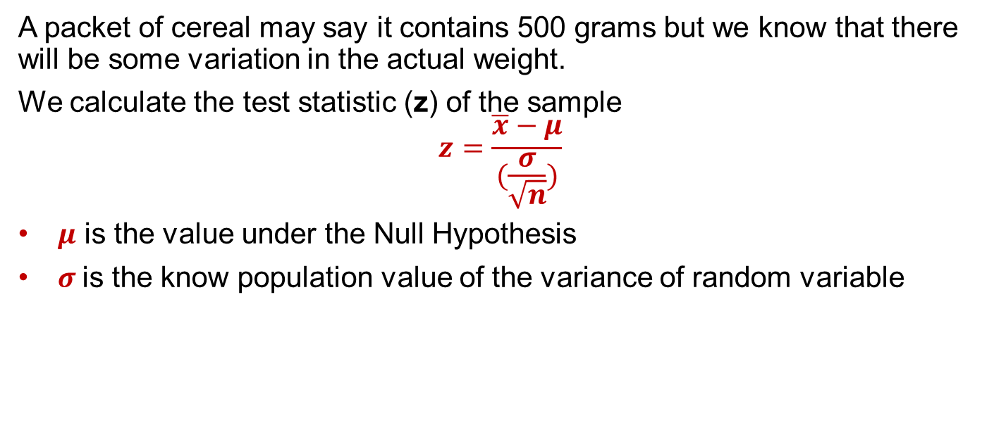
Calculate the test statistic
What to do?
A packet of cereal may say it contains 500 grams but we know that there will be some variation in the actual weight.
We calculate the test statistic (z) of the sample
$$z=\frac{\overline{x}−μ}{(\frac{σ}{\sqrt{n}})}$$
$μ$ is the value under the Null Hypothesis
$σ$is the know population value of the variance of random variable

Slide 21
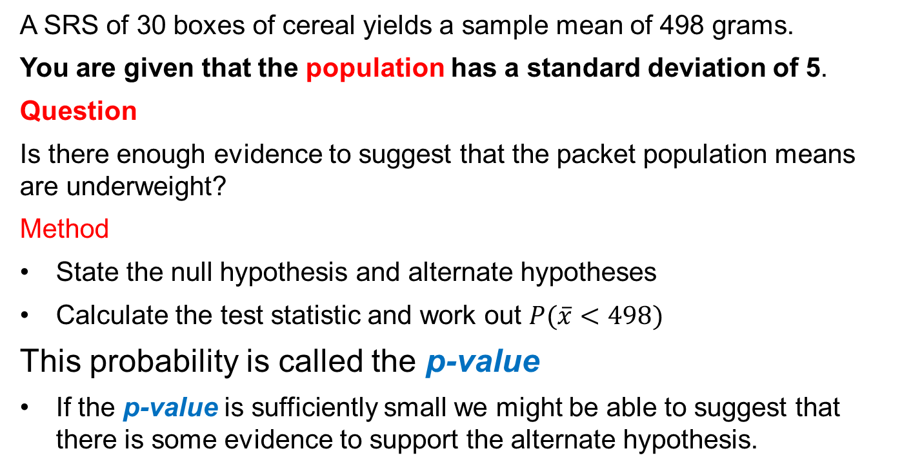
P-value
A SRS of 30 boxes of cereal yields a sample mean of 498 grams.
You are given that the population has a standard deviation of 5.
Question
Is there enough evidence to suggest that the packet population means are underweight?
Method
State the null hypothesis and alternate hypotheses
Calculate the test statistic and work out $P(\overline{x}<498)$
This probability is called the p-value
If the p-value is sufficiently small we might be able to suggest that there is some evidence to support the alternate hypothesis.

Slide 22
Can I just use p-values?
NO. By itself, a p-value does not provide a good measure of evidence regarding a model or hypothesis. It appears in lots of scholarly papers but that does not make it good practice.
In 2016 the American Statistical Association stated that:
P-values can indicate how incompatible the data are with a specified statistical model.
P-values do not measure the probability that the studied hypothesis is true, or the probability that the data were produced by random chance alone.
Scientific conclusions and business or policy decisions should not be based only on whether a p-value passes a specific threshold.
Proper inference requires full reporting and transparency.
A p-value, or statistical significance, does not measure the size of an effect or the importance of a result.
https://www.tandfonline.com/doi/full/10.1080/00031305.2016.1154108

Slide 23
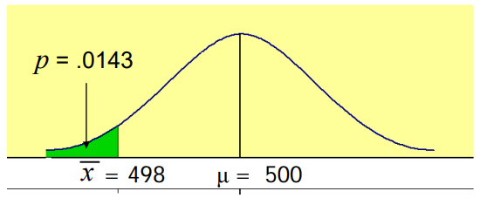
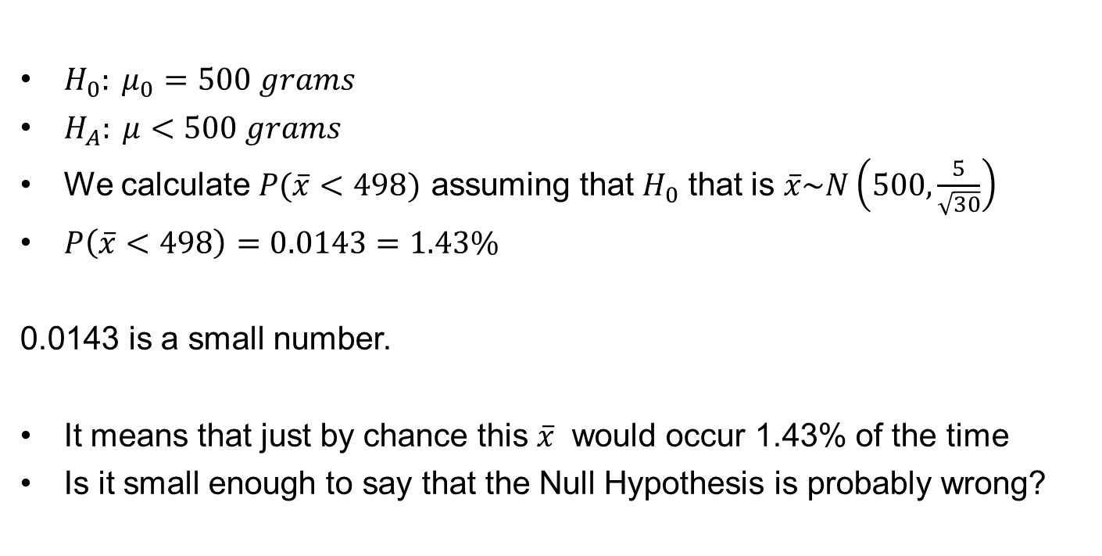
Is the p-value small enough?
$H_{0}: μ_{0}=500 grams$
$H_{A}: μ<500 grams$
We calculate $P(\overline{x}<498)$ assuming that $H_{0}$ that is $\overline{x}\sim N\left(500,\frac{5}{\sqrt{30}}\right)$
$P\left(\overline{x}<498\right)=0.0143=1.43\%$
0.0143 is a small number.
It means that just by chance this $\overline{x}$ would occur 1.43% of the time
Is it small enough to say that the Null Hypothesis is probably wrong?

Slide 24
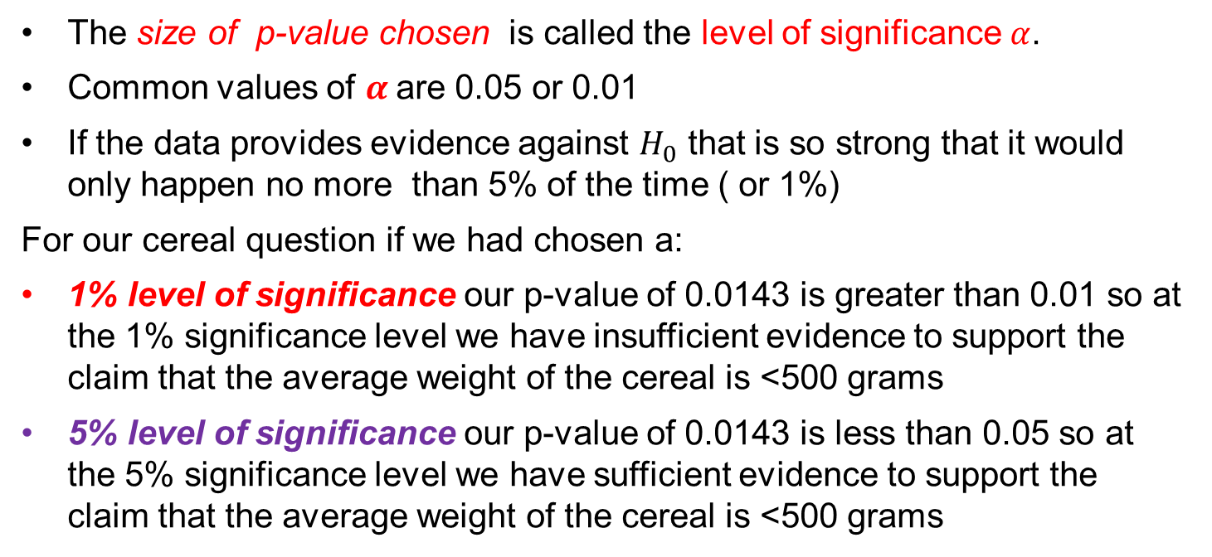
Level of significance
You must decide in advance how small a p-value is needed to reject $H_{0}$
The size of p-value chosen is called the level of significance $α$.
Common values of $α$are 0.05 or 0.01
If the data provides evidence against $H_{0}$ that is so strong that it would only happen no more than 5% of the time ( or 1%)
For our cereal question if we had chosen a:
1% level of significance our p-value of 0.0143 is greater than 0.01 so at the 1% significance level we have insufficient evidence to support the claim that the average weight of the cereal is <500 grams
5% level of significance our p-value of 0.0143 is less than 0.05 so at the 5% significance level we have sufficient evidence to support the claim that the average weight of the cereal is <500 grams

Slide 25
No absolutes in statistics
At the 1% significance level we are not saying the boxes do contain 500 grams, just that we have insufficient evidence to support the alternative hypothesis
At the 5% significance level we are not saying that the boxes do contain less than 500 grams, just that we have evidence to support the alternative hypothesis at this level of significance.

Slide 26
P values are not enough
You will see many papers that only have p-values it is not enough!
The American Statistical Association advises not to use p-values as the sole analysis.
In many papers you will see p-value claims but no access to the raw data. Be suspicious. The raw data should be accessible.
You may also have people say “but that is the way we do it in our specialty”. That is not a convincing argument.
So why are p-values here?
You are going to see them so this is a way of teaching you to be cautious of what people claim their analysis means.
The more complicated the statistical analysis the more cautious you should be about believing the conclusion.

Slide 27
Effect of dance on Gait
What does this mean?
Data were analyzed using Sigmastat software (Systat, Richmond, VA).
Participant baseline demographics and the exit questionnaire responses were compared for differences with:
One-way ANOVAs or Kruskall-Wallis one-way ANOVAs on ranks for non-parametric data.
Two way repeated measures ANOVAs (group [Partner, Non-partner] × time [pre, post, follow-up]), with Holms-Sidak post-hoc tests,
Determined statistical significance of changes from pre to post to follow-up.
Level of significance was set at p = 0.05.
Abreu, Mauro PT, DPT, GCS¹; Hartley, Greg PT, DPT, GCS^{1,2} The Effects of Salsa Dance on Balance, Gait, and Fall Risk in a Sedentary Patient With Alzheimer's Dementia, Multiple Comorbidities, and Recurrent Falls, Journal of Geriatric Physical Therapy: April/June 2013 - Volume 36 - Issue 2 - p 100-108 doi: 10.1519/JPT.0b013e318267aa54
Why?

Slide 28
Method: hypothesis testing
Choose an appropriate hypothesis.
You need to think about what you are testing for.
Decide on the level of significance
This is a chosen number.
Discuss all necessary assumptions and limitations.
It is not enough to say “assume srs”
Decide on a distribution.
For us it is either t or z.
Draw a bell curve & mark critical values of t/z that result from significance.
Calculate the test statistic and locate it on the curve.
State your conclusion but remember to include:
The word question
Assumptions and limitations.
A numerical statement.
Are you accepting the null or alternate hypothesis and why; refer calculations.
Make a recommendation for further action if necessary.

Slide 29
Example: Telephone calls
According to a telephone company’s records from 1999 the average length of a long distance call was 12.44 minutes with a standard deviation of 2.65 minutes
Management wants to check if the mean length of current long distance calls has changed from 12.44 minutes
A sample of 150 calls places through the company has a mean duration of 13.71 minutes.
Using a 5% significance level can you conclude that the mean length of all current long distance calls is different from 12.44 minutes?

Slide 30
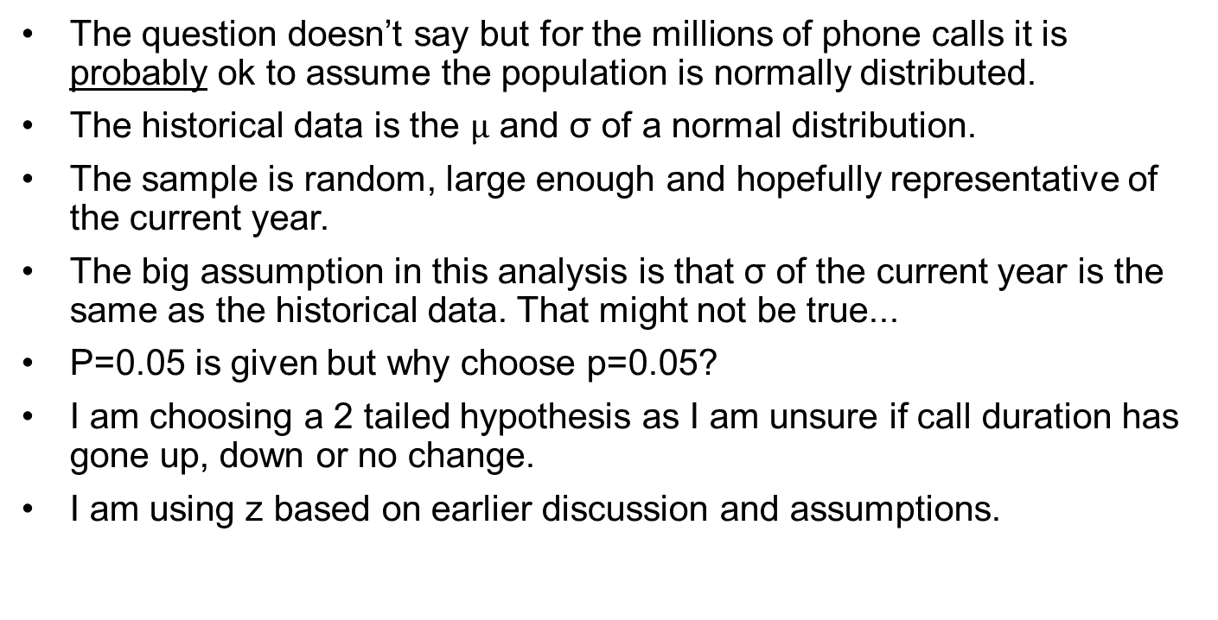
Discussion of assumptions
The question doesn’t say but for the millions of phone calls it is probably ok to assume the population is normally distributed.
The historical data is the $µ$ and σ of a normal distribution.
The sample is random, large enough and hopefully representative of the current year.
The big assumption in this analysis is that σ of the current year is the same as the historical data. That might not be true...
P=0.05 is given but why choose p=0.05?
I am choosing a 2 tailed hypothesis as I am unsure if call duration has gone up, down or no change.
I am using z based on earlier discussion and assumptions.

Slide 31
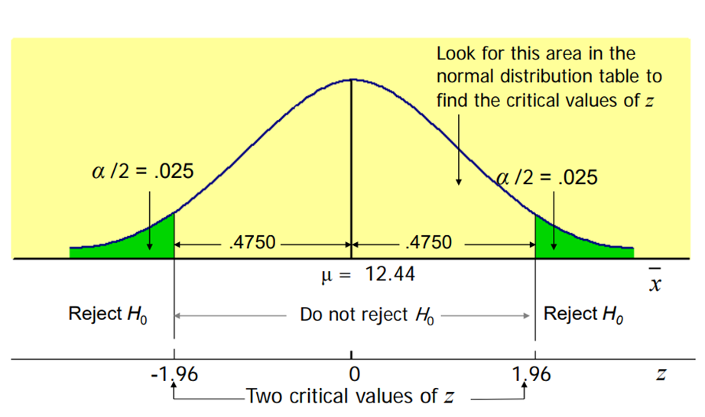

Calculations
$H_{0}: μ_{0}=12.44 minutes$
$H_{A}: μ_{A}≠12.44 minutes$
$significance=0.05= α,$
$therefore \frac{α}{2}=0.025$
$Critical values from z tables z=±1.96$
$μ=12.44, σ=2.65, n=150 , \overline{x}=13.71$
$Test statistic$
$z_{test}=\frac{\overline{x}−μ}{(σ/{\sqrt{n}})}= \frac{13.71−12.44}{{2.65}/{√150}}=5.87$
$z_{test}=5.87>z=+1.96$
Z=5.87

Slide 32
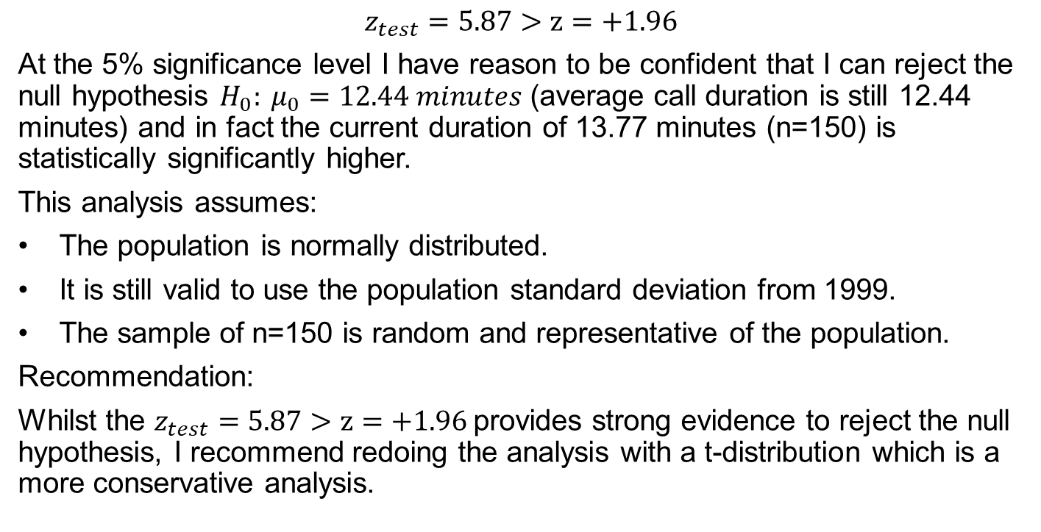
conclusion
$$z_{test}=5.87>z=+1.96$$
At the 5% significance level I have reason to be confident that I can reject the null hypothesis $H_{0}: μ_{0}=12.44 minutes$ (average call duration is still 12.44 minutes) and in fact the current duration of 13.77 minutes (n=150) is statistically significantly higher.
This analysis assumes:
The population is normally distributed.
It is still valid to use the population standard deviation from 1999.
The sample of n=150 is random and representative of the population.
Recommendation:
Whilst the $z_{test}=5.87>z=+1.96$provides strong evidence to reject the null hypothesis, I recommend redoing the analysis with a t-distribution which is a more conservative analysis.

Slide 33
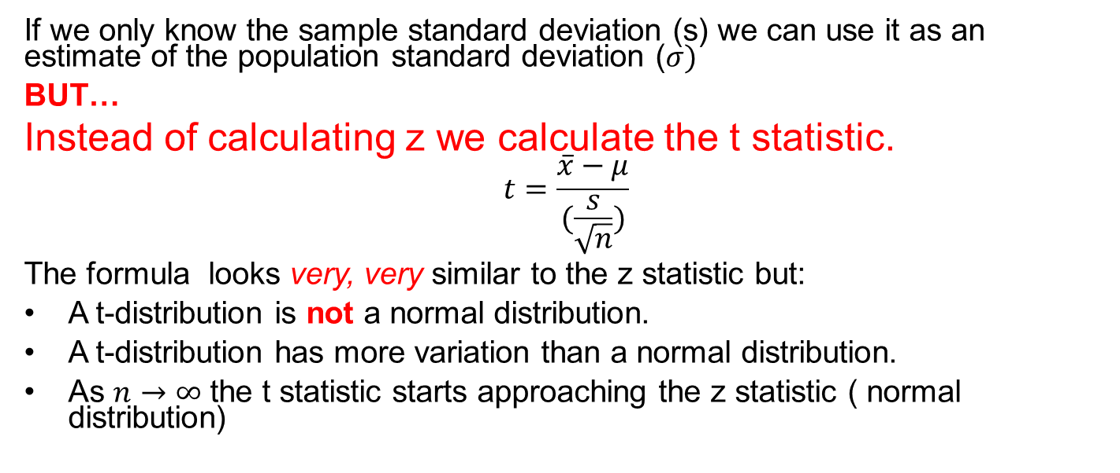
BIG PROBLEM: you only have the sample standard deviation…
Unfortunately we often do not know the population standard deviation
If we only know the sample standard deviation (s) we can use it as an estimate of the population standard deviation ($σ)$
BUT…
Instead of calculating z we calculate the t statistic.
$$t=\frac{\overline{x}−μ}{(\frac{s}{\sqrt{n}})}$$
The formula looks very, very similar to the z statistic but:
A t-distribution is not a normal distribution.
A t-distribution has more variation than a normal distribution.
As $n→∞$ the t statistic starts approaching the z statistic ( normal distribution)

Slide 34
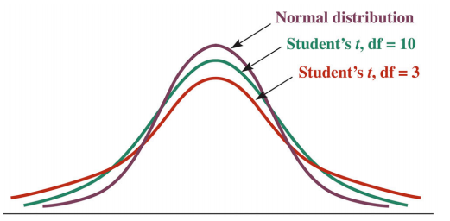
T-distribution
A t-distribution look similar to a normal distribution but you can see that it is more spread out. It has more variation
There are different t-distributions for each sample size
A t-distribution is defined by its degrees of freedom (DOF)
DOF = n-1
The larger the DOF the more “normal” the t-distribution looks.
You need to use tables!

Slide 35
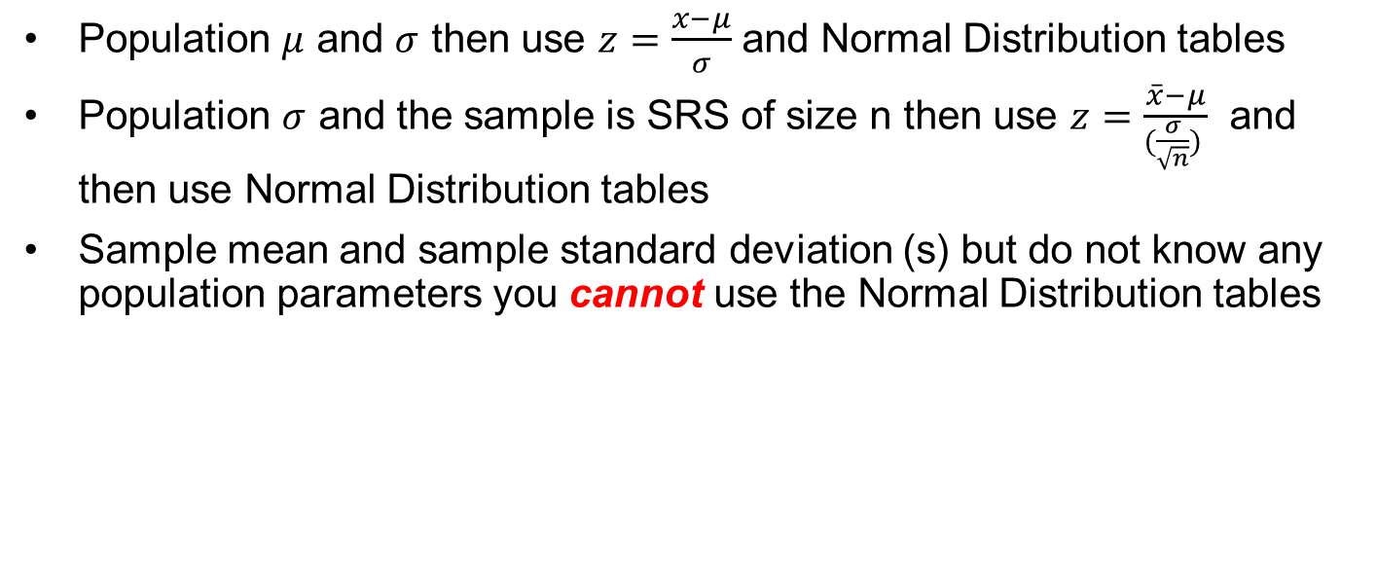
If I know…
Population $μ$ and $σ$ then use $z=\frac{x−μ}{σ}$ and Normal Distribution tables
Population $σ$ and the sample is SRS of size n then use $z=\frac{\overline{x}−μ}{(\frac{σ}{\sqrt{n}}) }$ and then use Normal Distribution tables
Sample mean and sample standard deviation (s) but do not know any population parameters you cannot use the Normal Distribution tables

Slide 36
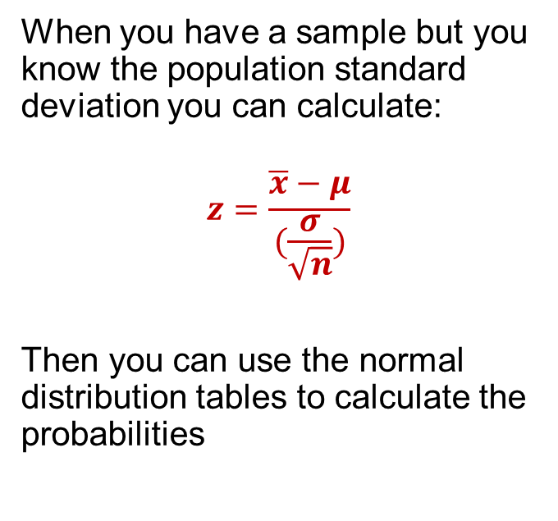


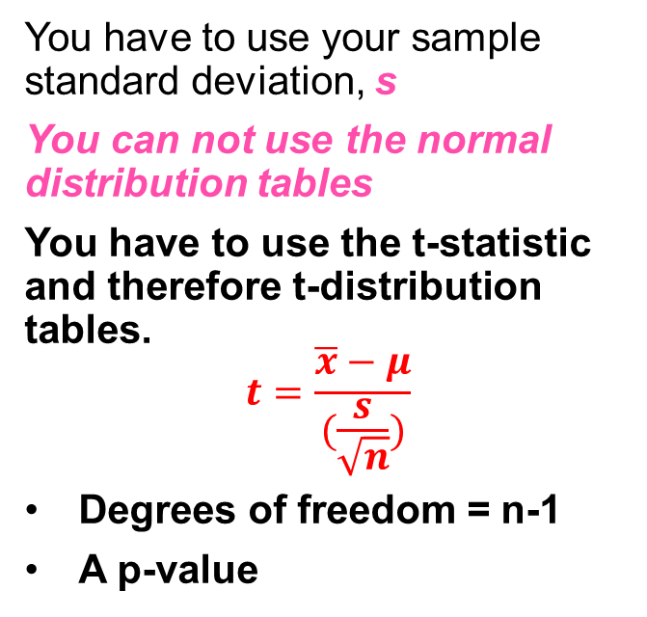

Known versus unknown Population standard deviation - $σ$
Known $σ$
Unknown $σ$
When you have a sample but you know the population standard deviation you can calculate:
$$z=\frac{\overline{x}−μ}{(\frac{σ}{\sqrt{n}})}$$
Then you can use the normal distribution tables to calculate the probabilities
You have to use your sample standard deviation, s
You can not use the normal distribution tables
You have to use the t-statistic and therefore t-distribution tables.
$$t=\frac{\overline{x}−μ}{(\frac{s}{\sqrt{n}})}$$
Degrees of freedom = n-1
A p-value

Slide 37
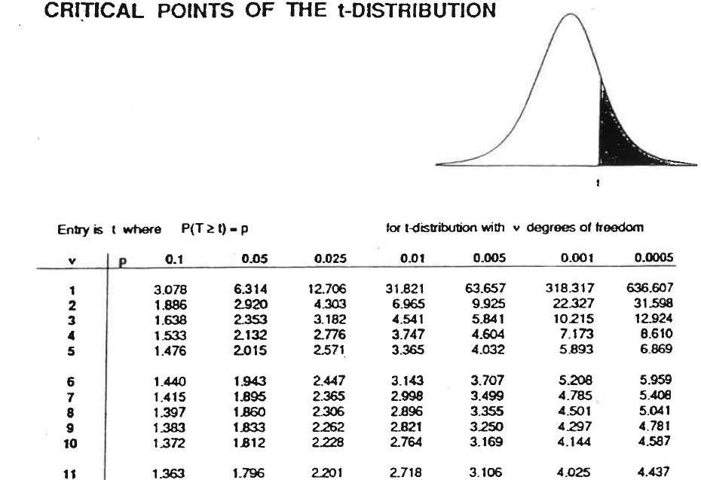
Degrees of freedom = n-1

Slide 38
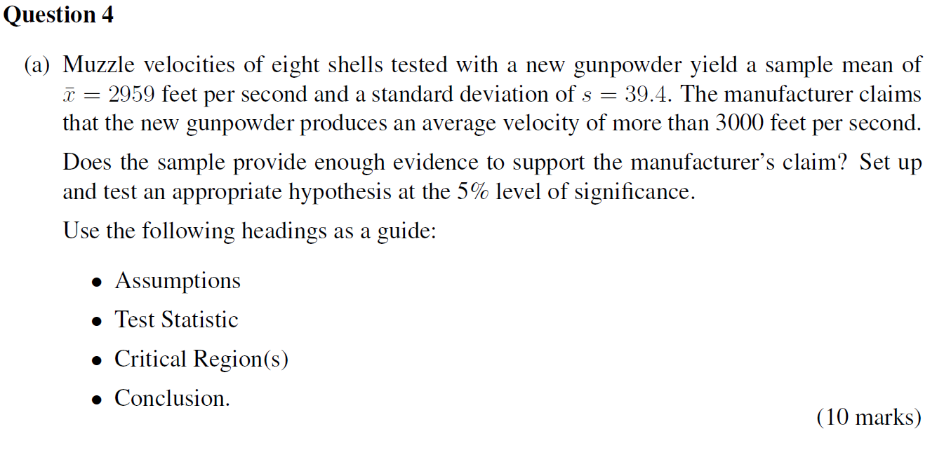
Exam question

Slide 39
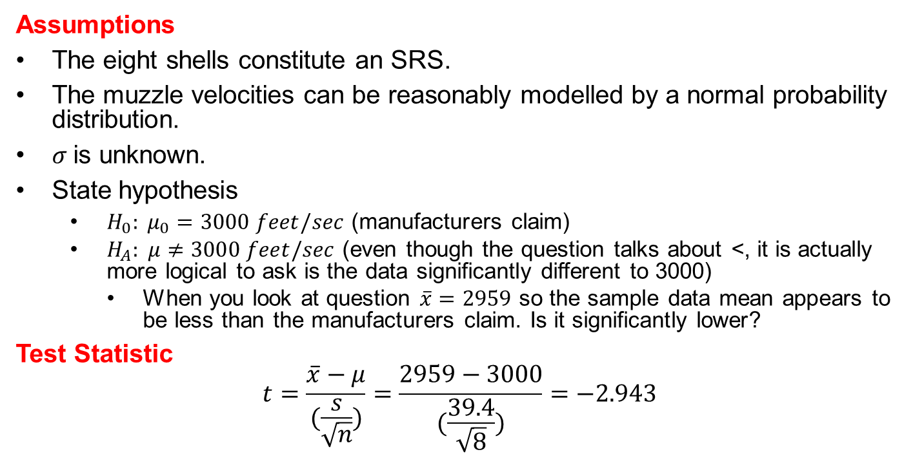
Solution – 2 tail step by step
Assumptions
The eight shells constitute an SRS.
The muzzle velocities can be reasonably modelled by a normal probability distribution.
$σ$is unknown.
State hypothesis
$H_{0}: μ_{0}=3000 feet/sec$ (manufacturers claim)
$H_{A}: μ≠3000 feet/sec$ (even though the question talks about <, it is actually more logical to ask is the data significantly different to 3000)
When you look at question $\overline{x}=2959$ so the sample data mean appears to be less than the manufacturers claim. Is it significantly lower?
Test Statistic
$$t=\frac{\overline{x}−μ}{(\frac{s}{\sqrt{n}})}=\frac{2959−3000}{(\frac{39.4}{\sqrt{8}})}=−2.943$$

Slide 40
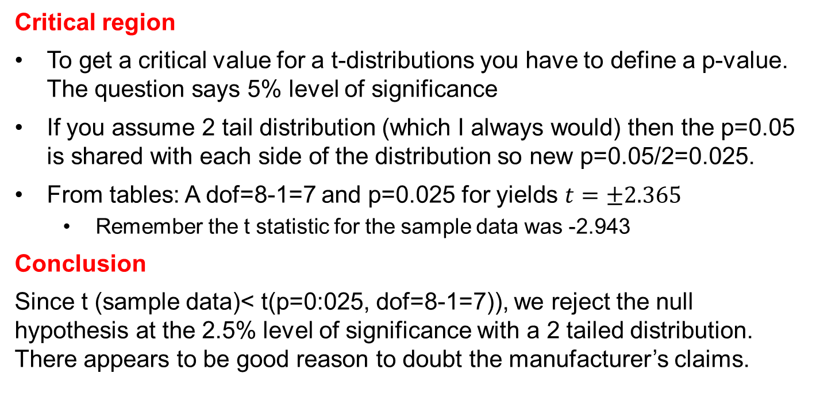
Solution – 2 tail critical region
Critical region
To get a critical value for a t-distributions you have to define a p-value. The question says 5% level of significance
If you assume 2 tail distribution (which I always would) then the p=0.05 is shared with each side of the distribution so new p=0.05/2=0.025.
From tables: A dof=8-1=7 and p=0.025 for yields $t=±2.365$
Remember the t statistic for the sample data was -2.943
Conclusion
Since t (sample data)< t(p=0:025, dof=8-1=7)), we reject the null hypothesis at the 2.5% level of significance with a 2 tailed distribution. There appears to be good reason to doubt the manufacturer’s claims.

Slide 41
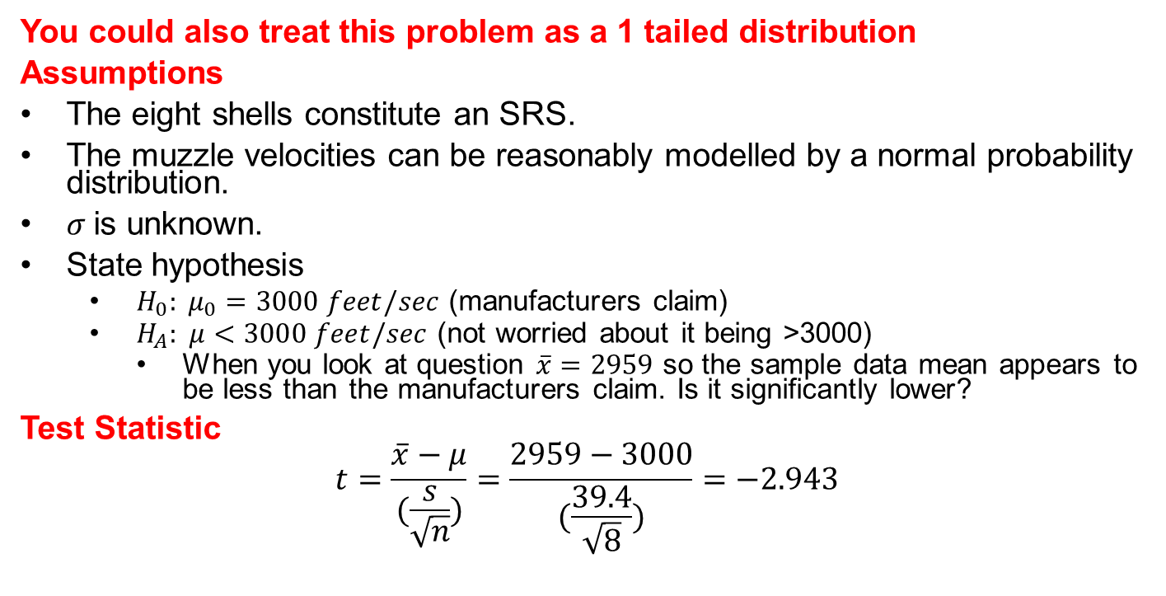
Solution – 1 tail step by step
You could also treat this problem as a 1 tailed distribution
Assumptions
The eight shells constitute an SRS.
The muzzle velocities can be reasonably modelled by a normal probability distribution.
$σ$is unknown.
State hypothesis
$H_{0}: μ_{0}=3000 feet/sec$ (manufacturers claim)
$H_{A}: μ<3000 feet/sec$ (not worried about it being >3000)
When you look at question $\overline{x}=2959$ so the sample data mean appears to be less than the manufacturers claim. Is it significantly lower?
Test Statistic
$$t=\frac{\overline{x}−μ}{(\frac{s}{\sqrt{n}})}=\frac{2959−3000}{(\frac{39.4}{\sqrt{8}})}=−2.943$$

Slide 42
Solution – 1 tail critical region
Critical region
To get a critical value for a t-distributions you have to define a p-value. The question says 5% level of significance and this is a 1 tailed distribution so p=0.05.
From tables: A dof=8-1=7 and p=0.05 for a 1 tailed yields t=1.895
Remember the t statistic for the sample data was -2.943
Conclusion
Since t (sample data)< t(p=0:05, dof=8-1=7)), we are inclined to reject the null hypothesis at the 5% level of significance and accept the alternate. There appears to be good reason to doubt the manufacturer’s claims about the velocity and it facts it appears to be significantly less than claimed..
Tt=-2.943

Slide 43
1 tail or 2 tail?
There are no definite answers in statistics
I have spoken to statisticians and doing a 2 tail distribution is usually valid and I think easier.
You just need to establish the confidence interval for the data and state a valid hypothesis
Then determine the t value for the significance and degrees of freedom
Remember you only use t distributions for certain conditions
If the t value for the significance and degrees of freedom, lies outside the confidence interval you can probably not accept the null hypothesis
If you chose a 1 tail distribution and your assumption was valid/reasonable, your work can still be correct even though your calculation and conclusion might be different to mine.

Slide 44
Blood question
The level of phosphate in blood varies normally over time. A dialysis patient has his level monitored on 6 visits to the clinic.
Set up and test an hypothesis at a 5% level of significance to decide if there is evidence that his level is above 4.8 which is the top of the range for healthy people?
5.6, 5.1, 4.6, 4.8, 5.7, 6.4
Use the following headings as a guide:
Assumptions ( this includes statement of Null & Alternate Hypothesis)
Test statistic
Critical region(s)
Conclusion

Slide 45
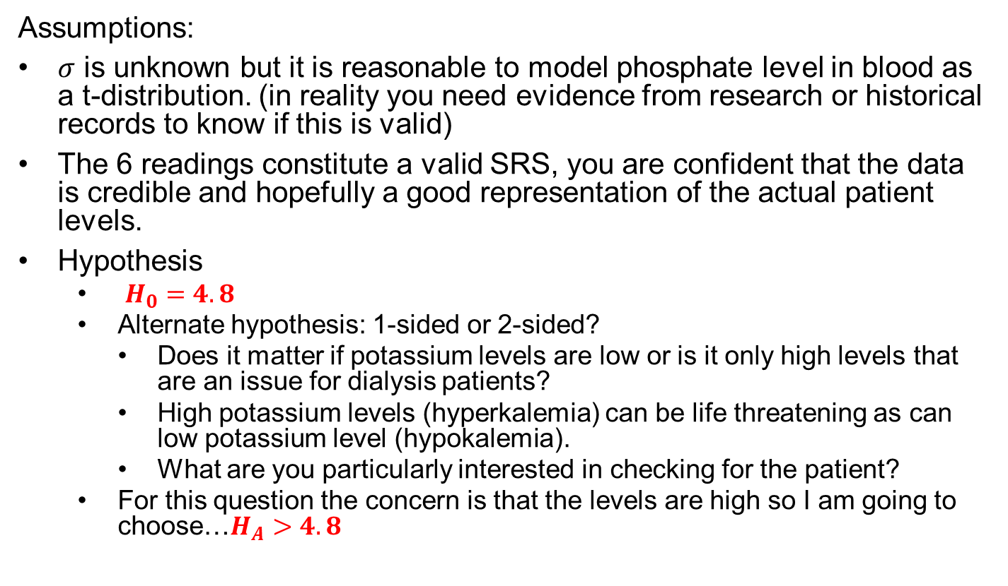
Assumptions:
$σ$ is unknown but it is reasonable to model phosphate level in blood as a t-distribution. (in reality you need evidence from research or historical records to know if this is valid)
The 6 readings constitute a valid SRS, you are confident that the data is credible and hopefully a good representation of the actual patient levels.
Hypothesis
$H_{0}=4.8$
Alternate hypothesis: 1-sided or 2-sided?
Does it matter if potassium levels are low or is it only high levels that are an issue for dialysis patients?
High potassium levels (hyperkalemia) can be life threatening as can low potassium level (hypokalemia).
What are you particularly interested in checking for the patient?
For this question the concern is that the levels are high so I am going to choose…$H_{A}>4.8$

Slide 46
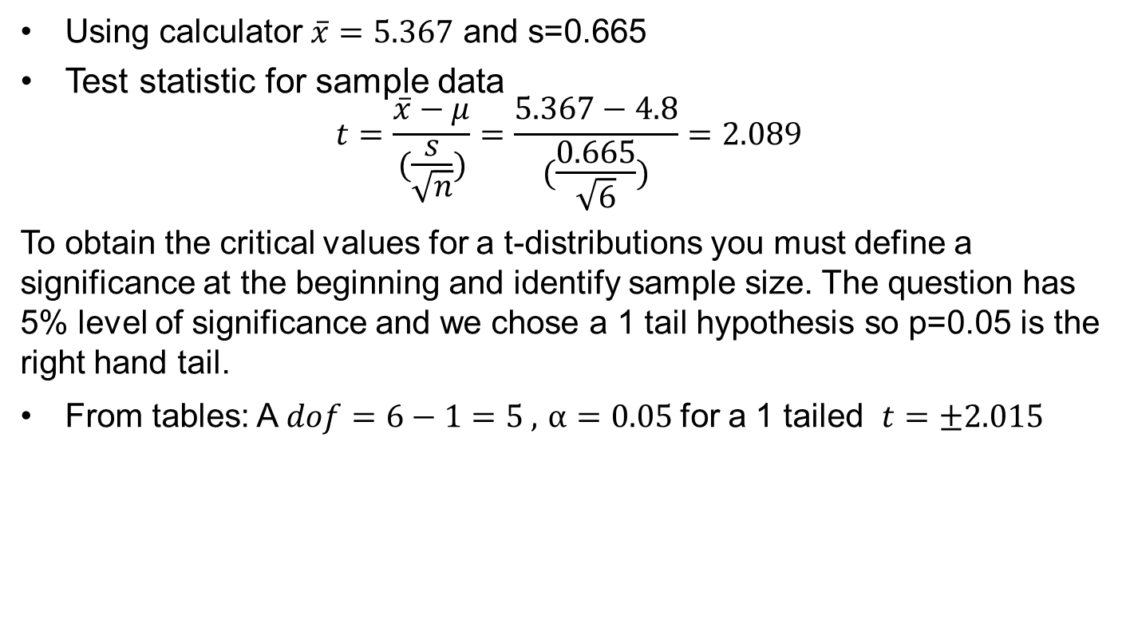
Test statistics & critical region
Using calculator $\overline{x}=5.367$ and s=0.665
Test statistic for sample data
$$t=\frac{\overline{x}−μ}{(\frac{s}{\sqrt{n}})}=\frac{5.367−4.8}{(\frac{0.665}{\sqrt{6}})}=2.089$$
To obtain the critical values for a t-distributions you must define a significance at the beginning and identify sample size. The question has 5% level of significance and we chose a 1 tail hypothesis so p=0.05 is the right hand tail.
From tables: A $dof=6−1=5 ,$ $α=0.05$for a 1 tailed $t=±2.015$

Slide 47
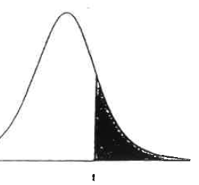
Blood solution conclusion
t (sample=2.089)> t=2.015 (p=0:05, dof=6-1=5)),
At the 5% significance level we have reason to be confident that we can reject the null hypothesis that the patients level are in the safe range and that the sample data indicates the average phosphate level of 5.367 is statistically significantly higher than 4.8 and the patient is at risk of hyperkalemia .
T=2.015

Slide 48
Could I have done this question as a 2-tail?
Yes or Maybe
I hope that you are seeing that the calculations are only a small part of the analysis.
You need to understand the topic you are analyzing.
Is the test for low phosphate the same as for high phosphate?
Why 5% significance? Why not 1%? (good question)

Slide 49
Could phone calls be a t question?
Yes… just let’s change the information in the question a little bit.
According to a telephone company’s records from 1999 the average length of a long distance call was 12.44 minutes with a standard deviation of 2.65 minutes
Management wants to check if the mean length of current long distance calls has changed from 12.44 minutes
A sample of 150 calls places through the company has a mean duration of 13.71 minutes and a sample standard deviation of 2.65 minutes. It is not known if the current σ is the same as all those years back.
Using a 5% significance level can you conclude that the mean length of all current long distance calls is different from 12.44 minutes?

Slide 50
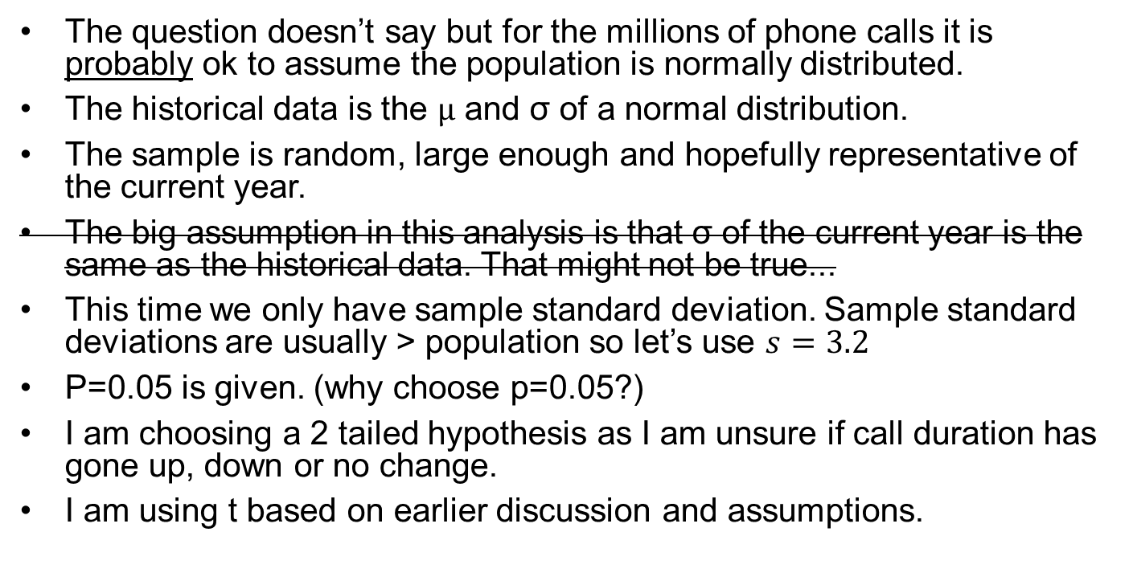
Discussion of assumptions
The question doesn’t say but for the millions of phone calls it is probably ok to assume the population is normally distributed.
The historical data is the $µ$ and σ of a normal distribution.
The sample is random, large enough and hopefully representative of the current year.
The big assumption in this analysis is that σ of the current year is the same as the historical data. That might not be true...
This time we only have sample standard deviation. Sample standard deviations are usually > population so let’s use $s=3.2$
P=0.05 is given. (why choose p=0.05?)
I am choosing a 2 tailed hypothesis as I am unsure if call duration has gone up, down or no change.
I am using t based on earlier discussion and assumptions.

Slide 51
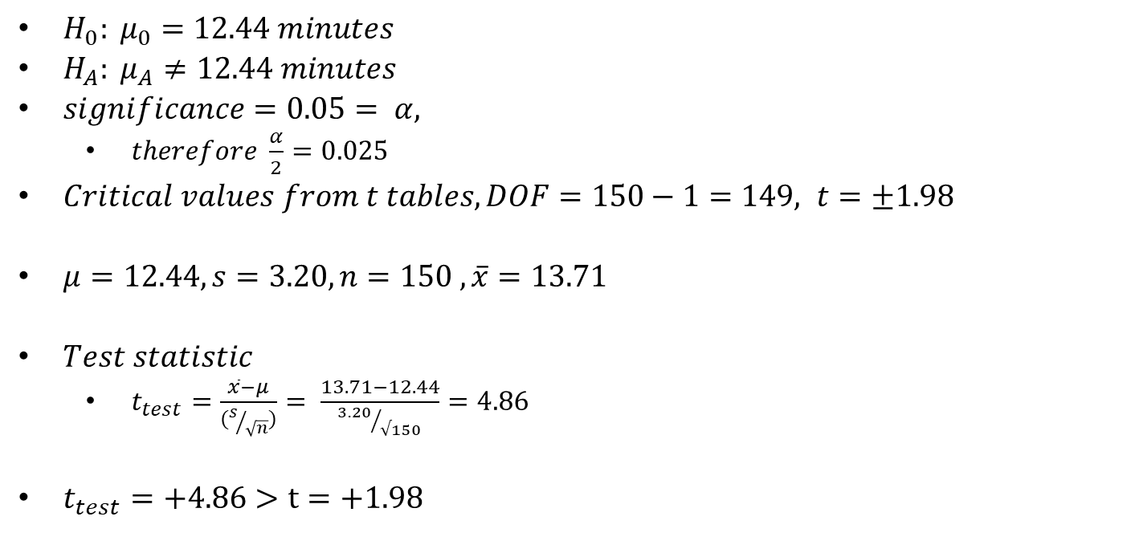
Calculations
$H_{0}: μ_{0}=12.44 minutes$
$H_{A}: μ_{A}≠12.44 minutes$
$significance=0.05= α,$
$therefore \frac{α}{2}=0.025$
$Critical values from t tables, DOF=150−1=149, t=±1.98$
$μ=12.44, s=3.20, n=150 , \overline{x}=13.71$
$Test statistic$
$t_{test}=\frac{\overline{x}−μ}{(s/{\sqrt{n}})}= \frac{13.71−12.44}{{3.20}/{√150}}=4.86$
$t_{test}=+4.86>t=+1.98$

Slide 52
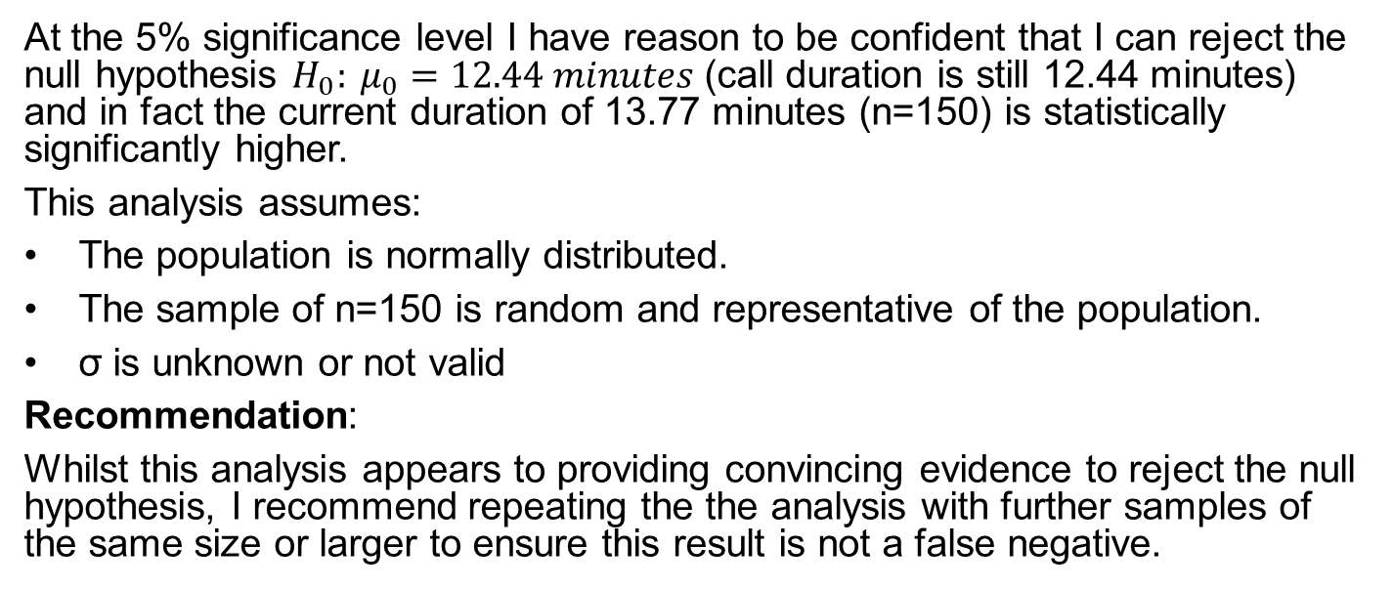
Conclusion with a t
$$t_{test}=4.86>t=+1.98$$
At the 5% significance level I have reason to be confident that I can reject the null hypothesis $H_{0}: μ_{0}=12.44 minutes$ (call duration is still 12.44 minutes) and in fact the current duration of 13.77 minutes (n=150) is statistically significantly higher.
This analysis assumes:
The population is normally distributed.
The sample of n=150 is random and representative of the population.
σ is unknown or not valid
Recommendation:
Whilst this analysis appears to providing convincing evidence to reject the null hypothesis, I recommend repeating the the analysis with further samples of the same size or larger to ensure this result is not a false negative.

Slide 53
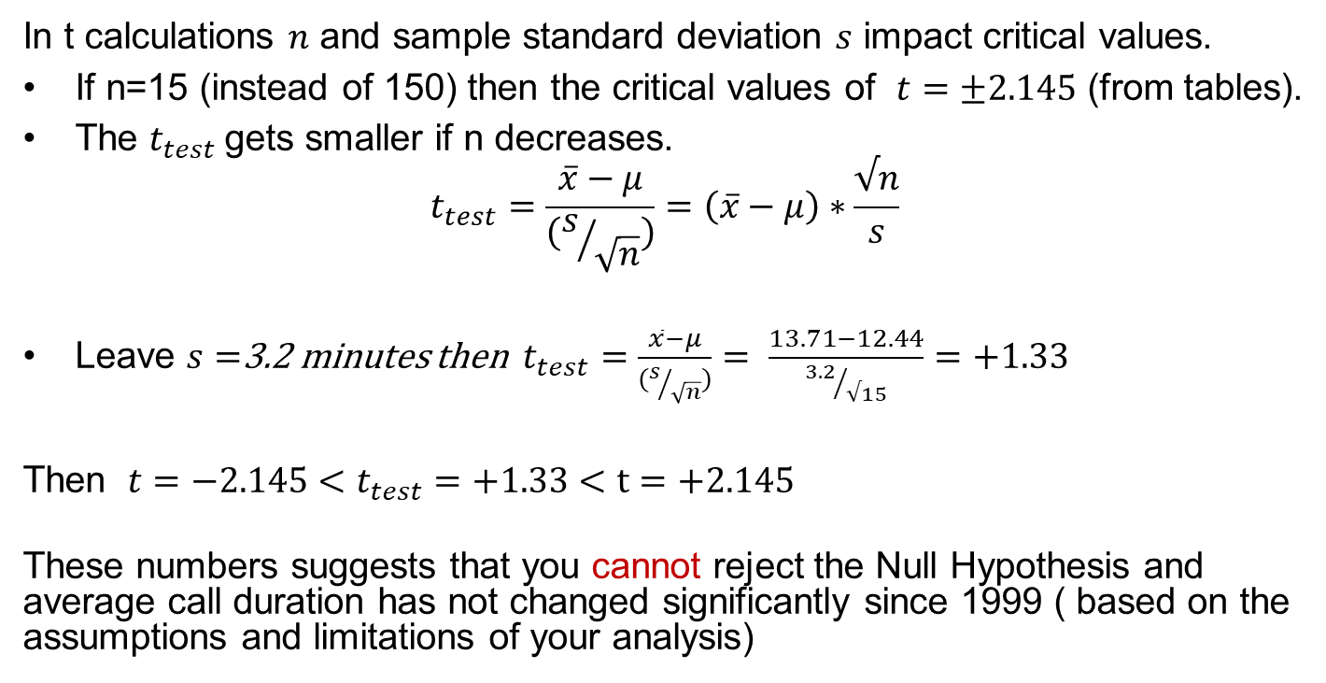
How sample size impacts t
Phone calls
In t calculations $n$ and sample standard deviation $s$ impact critical values.
If n=15 (instead of 150) then the critical values of $t=±2.145$ (from tables).
The $t_{test}$gets smaller if n decreases.
$$t_{test}=\frac{\overline{x}−μ}{(s/{\sqrt{n}})}=\left(\overline{x}−μ\right)∗\frac{√n}{s}$$
Leave $s=$3.2 minutes then $t_{test}=\frac{\overline{x}−μ}{(s/{\sqrt{n}})}= \frac{13.71−12.44}{{3.2}/{√15}}=+1.33$
Then ${t=−2.145<t}_{test}=+1.33<t=+2.145$
These numbers suggests that you cannot reject the Null Hypothesis and average call duration has not changed significantly since 1999 ( based on the assumptions and limitations of your analysis)

Slide 54
Confused?
What does this mean?
If I want to mislead you I can CHOOSE a significance and a sample size that suits me.
You need to understand the assumptions and limitations of an analysis.
Do not just accept the final answer or conclusion of any analysis.
An analysis can be any calculations, not just statistics!
This does not mean all statistics are lies but they must be fit for purpose.

Slide 55
Kitchen and confidence
A manufacturer of kitchen mixers employs a market research firm to estimate retail sales of its product by gathering information from a sample of retail stores.
In the last month a SRS of 50 stores found the average number of their mixers sold is 24 with standard deviation of 11.
Question
Determine the 95% confidence interval for the mean number of mixers sold by all stores in the region
The distribution of sales is strongly right skewed because there are many smaller stores and only a few large stores. The use of t in the first question is reasonable safe despite the store sizes not being normally distributed. WHY?
Central Limit Theorem (CLT) of course!
As the sample size is large the sample means will be approximately normally distributed even though the parent population is not.

Slide 56
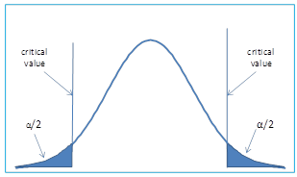

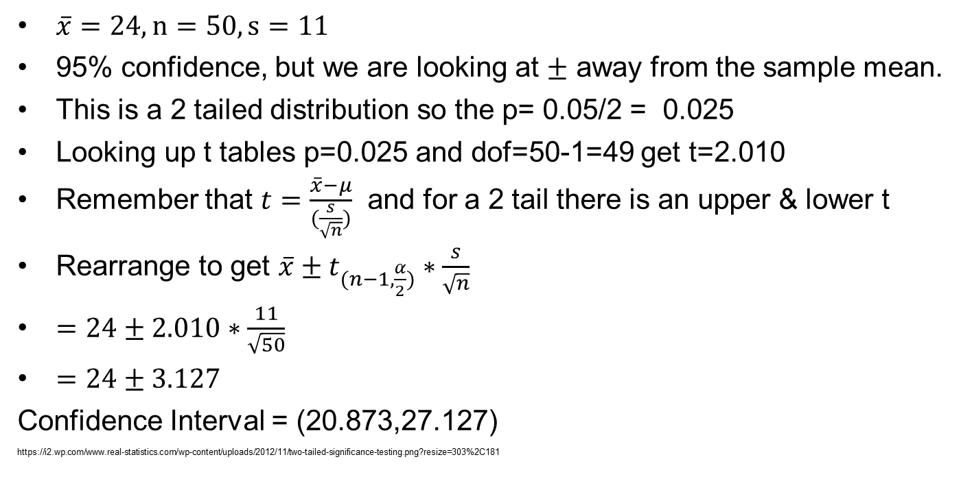


Kitchen - Do not know $σ$ use t
$\overline{x}=24, n=50, s=11$
95% confidence, but we are looking at $±$ away from the sample mean.
This is a 2 tailed distribution so the p= 0.05/2 = 0.025
Looking up t tables p=0.025 and dof=50-1=49 get t=2.010
Remember that $t=\frac{\overline{x}−μ}{(\frac{s}{\sqrt{n}})}$ and for a 2 tail there is an upper & lower t
Rearrange to get $\overline{x}±t_{(n−1, \frac{α}{2})}∗\frac{s}{\sqrt{n}}$
$=24±2.010∗\frac{11}{\sqrt{50}}$
$=24±3.127$
Confidence Interval = (20.873,27.127)
https://i2.wp.com/www.real-statistics.com/wp-content/uploads/2012/11/two-tailed-significance-testing.png?resize=303%2C181
t=-2.010 $\overline{x}=20.873$
t=0 or $\overline{x}$= 24
t=+2.010 $\overline{x}=27.127$

Slide 57
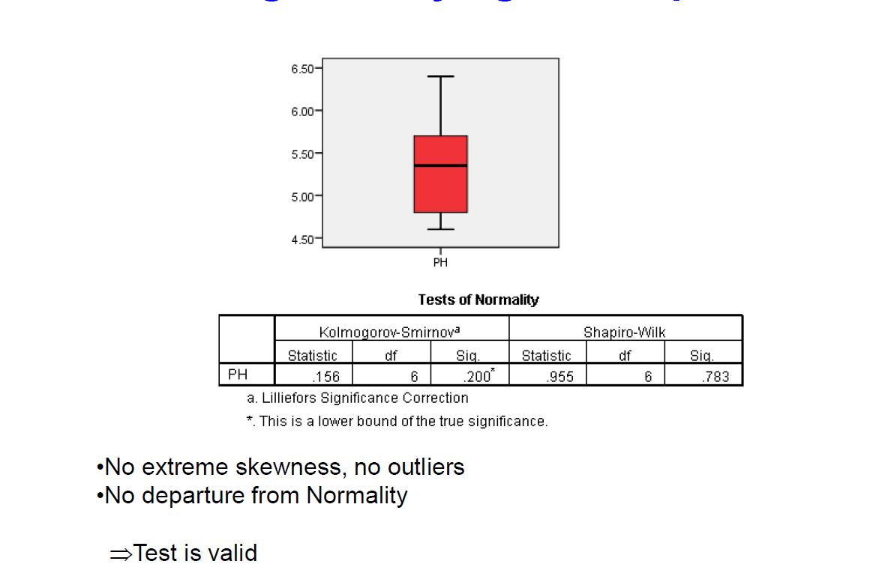
Using statistical packages for bigger data sets
Check underlying assumption where ever possible

Slide 58
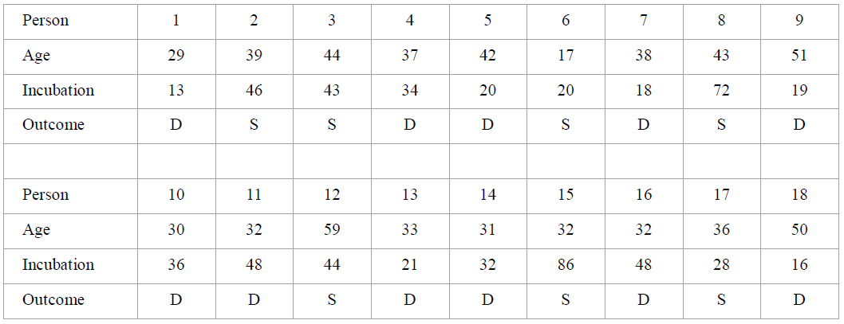
Food poisoning
This table provides data on a group of people who contracted botulism, a potentially fatal food poisoning.
The variables record: age, incubation period (the time in hours between eating the infected food and the first sign of illness),and whether the person survived (S) or died(D).
Test if the mean incubation period for the population is more than 30 days with a confidence of 95%.

Slide 59


Hypothesis & test assumptions
Null Hypothesis – mean incubation period = 30 days
Alternate Hypothesis – mean incubation period is more than 30 days
First of all check Normality assumptions
Box plot looks “ok” – fairly symmetrical
Shapiro-Wilk Sig is >0.05
Test is valid

Slide 60


Test statistic, Critical region & Conclusion
t(95%)=1.74
The outputs for the sample are.
$\overline{x}=35.7778$, s= 19.7917
Test statistic: $t=\frac{\overline{x}−μ}{(\frac{s}{\sqrt{n}})}=\frac{35.7778−30}{(\frac{19.7917}{\sqrt{18}})}=1.239$
Critical region :
95% confidence 1 tail with dof = 18-1=17
t=1.74
Test t=1.239 < t(95% confidence)=1.74
With a 95% confidence we can accept the Null Hypothesis that a sample mean incubation period as high as 35.78 would occur if the µ= 30 days.
Conclusion
The data does not support the claim that the mean incubation period is more than 30 days.( t=1.239, dof=17, one tailed)
As Test t=1.239 < t(95% confidence)=1.74
.
t=+1.239 $\overline{x}=35.7778$

Slide 61
Do not “guesstimate” significance
I find this result amazing. Remember the question was:
Test if the mean incubation period for the population is more than 30 days with a confidence of 95%.
Because we did not know the population standard deviation we had to use a t distribution which is more spread out.
Even though the sample mean was 35.7778, it is not sufficiently statistically different from 30 for us to be confident that this is more than natural variation in sample means based on the information we had.

Slide 62

Formulae summary

Slide 63


Past CU exam questions

